Slide 1
Data Structures and Algorithms -3 (25CS2103E)
Title of the project
Team Members
Poojitha:2520030110
Aashritha:2520030178
Nikhitha:2520030033
Under the Esteemed Guidance of
Sirisha

Slide 2
Contents
Abstract
Introduction
Literature survey
Problem Statement and Objectives
Hardware and Software requirements
Results
Conclusion
Future Scope

Slide 3
Abstract
The Event Management System is designed to provide a simple and efficient platform for managing events digitally.
It allows users to view available events, check event details, monitor crowd levels, and create personalized schedules.
The system helps organizers manage event information, bookings, and participant details effectively.
Data Structures and Algorithms such as AVL Trees, Graphs, Heaps, and Greedy Algorithms can be used to improve searching, scheduling, route planning, and event ranking.
This system reduces manual work, avoids scheduling conflicts, and improves the overall event management process.

Slide 4
Introduction
The Event Management System is a digital platform designed to simplify the process of planning and managing events.
It allows users to view event details, check schedules, and register or book events easily.
Organizers can efficiently manage event information, participants, and bookings.
The system reduces manual work and helps avoid scheduling conflicts.
It also improves event organization through features such as crowd monitoring and smart scheduling.
Overall, the system provides a simple, efficient, and user-friendly solution for modern event management.

Slide 5
Literature Survey
Existing event management systems provide features such as event registration, ticket booking, schedule management, and participant tracking.
However, many traditional systems mainly focus on basic event and booking management.
The proposed system improves the process by providing digital event management, ticket availability checking, crowd monitoring, and schedule organization.
It helps reduce manual work, avoid scheduling conflicts, and improve the overall event management experience.

Slide 6
Problem Statement and Objectives
Problem Statement:
Managing events manually can be difficult and time-consuming. Organizers may face problems in handling event details, participant registrations, bookings, schedules, and crowd management. Manual systems can also lead to scheduling conflicts and inefficient event organization. Therefore, the Event Management System is developed to provide a digital and efficient solution for managing events.
Objectives:
To provide a simple platform for managing event details digitally.
To allow users to view, register, and book events easily.
To manage participant details and event schedules efficiently.
To reduce scheduling conflicts and manual work.
To monitor bookings and crowd levels effectively.
To use suitable Data Structures and Algorithms for efficient event searching and management.

Slide 7
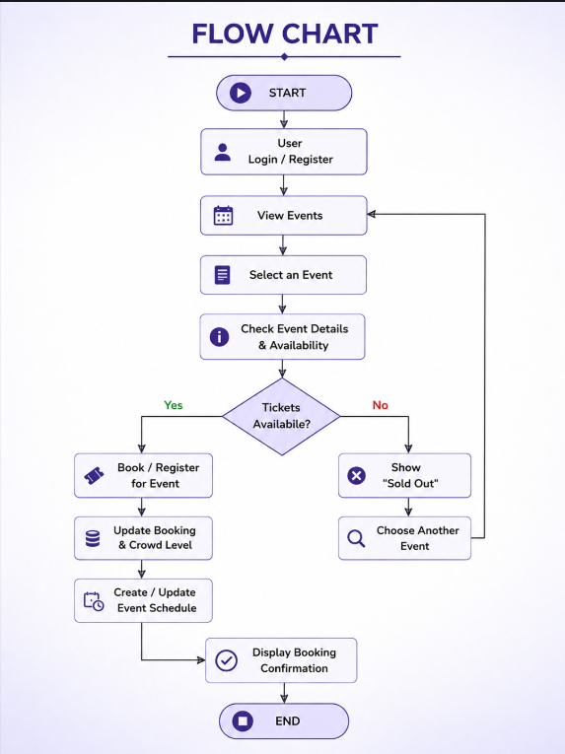
Flow Chart

Slide 8
Results
The Event Management System was successfully designed to manage events digitally and efficiently.
Users can view event details, select and book events, and check ticket availability.
The system helps manage bookings, participant information, and event schedules.
Crowd levels are updated based on the number of bookings. The system reduces manual work and helps avoid scheduling conflicts.
Overall, the system provides a simple, organized, and user-friendly event management experience.

Slide 9
Hardware and Software requirements
Hardware Requirements:
Computer/Laptop with minimum 4 GB RAM
Intel i3 processor or above
Minimum 10 GB free storage
Internet connection
Software Requirements:
Operating System: Windows 10/11 or Ubuntu
Frontend: HTML, CSS, JavaScript
Backend: Node.js
Database: MySQL
Code Editor: VS Code
Web Browser: Google Chrome

Slide 10
Conclusion
The Event Management System provides an efficient and organized way to manage events digitally.
It allows users to view events, check crowd levels, create schedules, and plan routes easily.
The system helps organizers manage event details and monitor bookings effectively.
DSA concepts such as AVL Trees, Graphs, Heaps, and Greedy Algorithms improve the system's efficiency.
It reduces manual work, avoids scheduling conflicts, and improves the overall event experience.
Thus, the system provides a smart and effective solution for modern event management.

Slide 11
Future Scope
AI-based event recommendations can be added based on user interests.
Real-time crowd monitoring can be implemented using IoT sensors.
Online payment gateways can be integrated for ticket booking.
QR-code-based digital tickets can be introduced for faster entry.
A mobile application can be developed for easy event access.
Data analytics can be used to predict event popularity and improve future event planning.

Slide 12
Thank you

